Slide 1

Towards Textual Inference for Eligibility Criteria Resolution in Clinical Trials
Chaitanya Shivade
2014 i2b2 Challenge
Track: Novel Usage of Data
14th November 2014

Slide 2
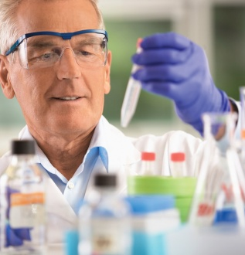

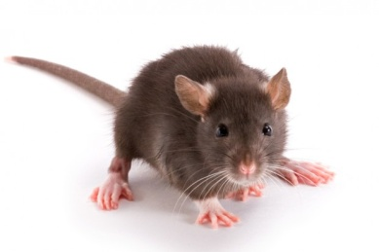

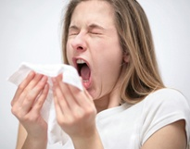


Clinical trials turn scientific discoveries into practice
Drug discovery
Target identification, In silico, In vitro, In vivo
Clinical Trials
Phase I, II, III
Stakeholders
NIH, Drug Companies, Universities
66% Trials fail because of low recruitment
Failures: Finances, Intellectual, and more

Slide 3
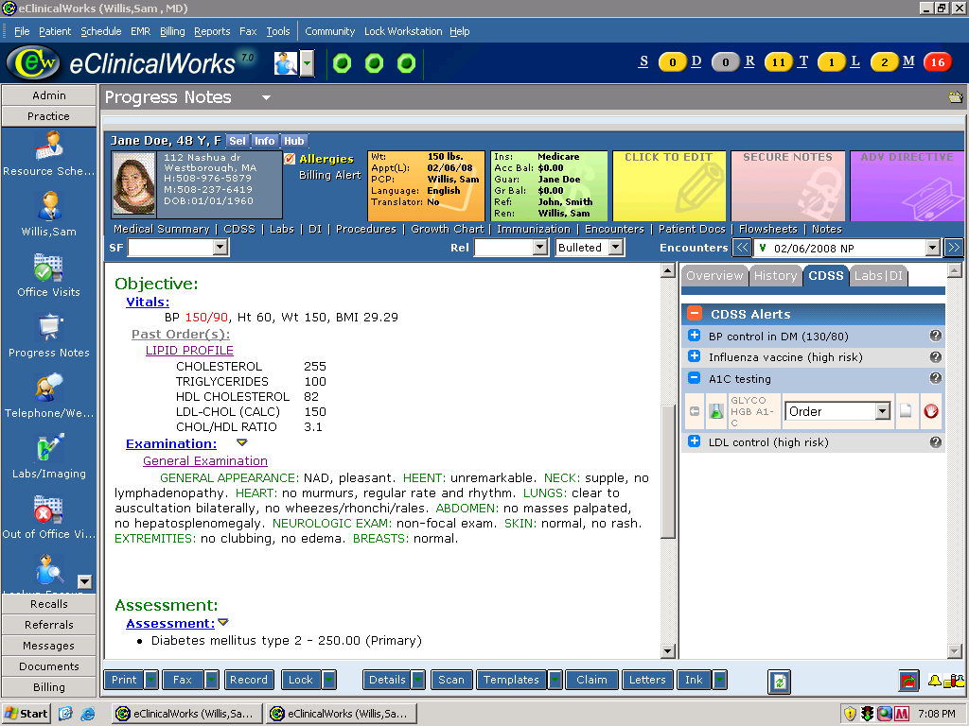
Clinical trial screening today
Screen patient population
In limited time
Achieve significant sample size
Manual chart review
Repeated reading of notes
Intricate eligibility criteria

Slide 4
Clinical trial screening today
Lenalidomide and Vaccine Therapy in Treating Patients With Early-Stage Asymptomatic Chronic Lymphocytic Leukemia or Small Lymphocytic Lymphoma
ClinicalTrials.gov Identifier
NCT01351896
Eligibility
Inclusion
Age >= 18 years and < 80 years (or with justification if older than 80 years)
Creatinine clearance >= 60 mL/min/1.73 m^2 for patients with creatinine levels above institutional normal according to the Cockcroft-Gault formula
Progressive splenomegaly and/or lymphadenopathy identified by physical examination or radiographic studies
Exclusion
Patients may not be receiving any other investigational agents
Patients who have developed erythema nodosum characterized by a desquamating rash while taking thalidomide or similar drugs in the past are excluded
Screen patient population
In limited time
Achieve significant sample size
Manual chart review
Repeated reading of notes
Intricate eligibility criteria
Sponsor
National Cancer Institute

Slide 5

Clinical trial screening today
Screen patient population
In limited time
Achieve significant sample size
Manual chart review
Repeated reading of notes
Intricate eligibility criteria
Inefficient
Time
Human Effort
Financial resources

Slide 6

Proposition: Faster Clinical Trial Screening
Identify criterion relevant text
Use textual inference
Semi-automated solution
Maintain human reliability
Easy workflow integration
Faster screening, more patients

Slide 7
Textual Inference
Given textual expressions text T and hypothesis H, determine whether humans reading T would infer that H is true.
Examples
Text : A Filipino hostage in Iraq was released.
Hypothesis : A Filipino hostage was freed in Iraq.
Text: Satomi Mitarai died of blood loss.
Hypothesis: Satomi Mitarai bled to death.

Slide 8
Recognizing Textual Entailment [RTE 2004-2010]
Answers
RTE 1-3 : Yes or No
RTE 4-7 : Yes, No or Unknown
Hypothesis
7-10 words
Text
RTE 1 : 24 words
RTE 5 : 99 words
Nature of task
RTE 1-5 : Recognition based
RTE 6-7 : Search based
Dataset construction
Synthetic: Using text summarization
Domain
Newswire

Slide 9
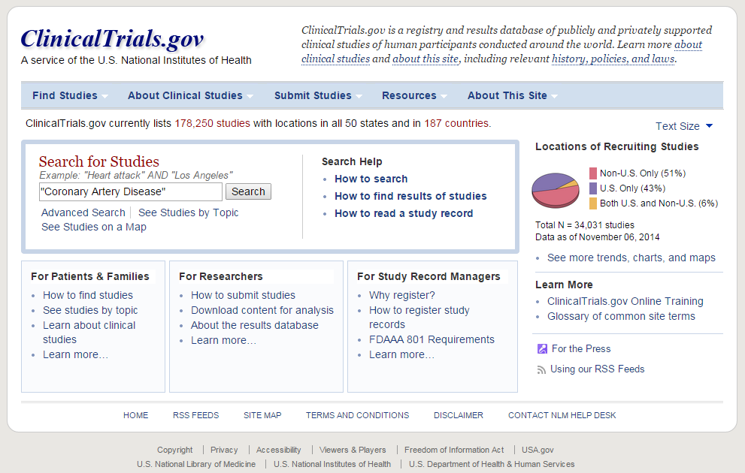
Candidate Eligibility Criteria
2014 i2b2 NLP Challenge Data
Patients with no CAD
Patients who developed CAD
Patients who had CAD
Used ClinicalTrials.gov
Query: “Coronary Artery Disease”
5054 Trials
Extracted Eligibility Criteria

Slide 10
Chosen Eligibility Criteria
Hand picked criteria
Cannot use structured data
Mandate reading notes
Commonly used
Semantic Analysis
Most common concept
Medical History
Lesion
Most common symptom
Angina
Criteria statements
Known location of a coronary artery lesion.
History of revascularization procedure.
Grade I angina: Angina on strenuous exertion or recreation.
Grade IV angina: Marked limitation of ordinary physical activity.

Slide 11
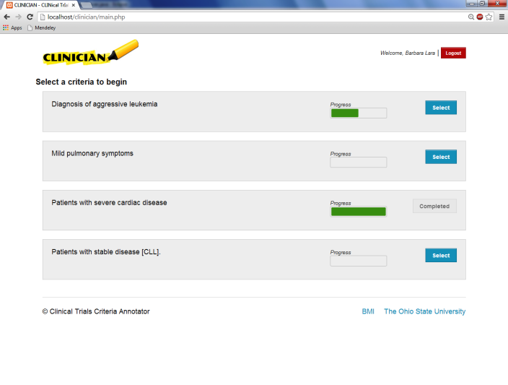
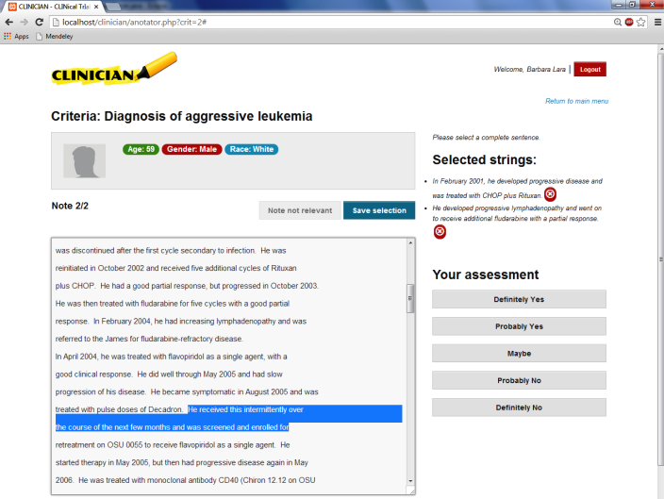
CLINical TrIals CriterIa ANnotator

Slide 12

Agreement analysis
Annotators
Three nursing college students
One physician
Metrics
Note relevance
Assessment [Yes/No/Maybe]
Sentence
Metric | Overall | Criterion 1 | Criterion 2 | Criterion 3 | Criterion 4
Note relevance | 0.858 | 0.751 | 0.883 | 0.810 | 0.948
Criterion Assessment | 0.795 | 0.769 | 0.818 | 0.611 | 0.846
Sentence relevance | 0.799 | 0.758 | 0.784 | 0.825 | 0.813

Slide 13
Textual Inference in clinical domain is harder
RTE Hypothesis
Synthetic, No ambiguity, Concise
RTE Text
Newswire: NLP friendly English
Word Overlap
RTE 1 : 69.25%
RTE 5 : 77.14%
Eligibility Criteria
Real World
Clinical Text
Inconsistent, abbreviations, misspell, ..
Word Overlap
Our data: 17% mean

Slide 14
Implemented simple baseline methods
Lexical methods
Local lexical matching
Lucene based matching
Example
Known location of coronary artery lesion.
A lesion was found in the innermost layer of the artery wall.
The artery has a lesion compromising 80% blood flow.
Semantic methods
Concept matching
UMLS:: Similarity based matching
Example
History of revascularization procedure
Cardiac Hx: Revascularization in 2002.
Patient feels much better after undergoing CABG

Slide 15
Semantic methods are promising
F1 of four baseline methods
Method | Criterion 1 | Criterion 2 | Criterion 3 | Criterion 4 | Overall
Local Lexical Matching | 50.00 | 12.24 | 18.75 | 8.92 | 17.19
Lucene-based Matching | 44.44 | 00.00 | 8.51 | 7.14 | 12.00
Simple Concept Matching | 29.41 | 13.48 | 19.78 | 11.00 | 16.09
UMLS Similarity Matching | 28.12 | 13.48 | 46.28 | 10.16 | 25.00

Slide 16

Conclusion
Clinical Trial Screening today
Manual, expensive and slow
Use of textual inference
Easily integrates into current workflow
Evaluation of baseline methods
Confirms that this is a hard problem
Semantic methods are promising

Slide 17
Acknowledgements
I2B2
Organizers and Reviewers
Advisors
Eric Fosler-Lussier [CSE]
Albert Lai [BMI]
Collaborators
Marie-Catherine de Marneffe [Linguistics]
Courtney Hebert [BMI]
Marcelo Lopetegui [BMI]
Annotators
Alissa Schultz
Jennifer Fox
Jessica Schellenbach

Slide 18
Questions? shivade@cse.osu.edu

